Slide 1

Frontend JavaScript
Web Fundamentals
www.pragmatic.bg
Lector: Stiliyan Ivanov
Skype: stiliyan.iv.ivanov
E-mail: stiliyan.ivanov [at] pragmatic.bg
Facebook: https://www.facebook.com/stiliyan.iv.ivanov
LinkedIn: https://www.linkedin.com/in/stiliyan-iv-ivanov/
Copyright © Pragmatic LLC 2013 – 2019

Slide 2
Table of Contents
Web sites and web applications
Web 1.0, 2.0, 3.0, etc…
Web browsers
Servers – hardware and software
Web servers
Client-Server architecture
3-Tier / Multi-Tier architectures
Service-Oriented Architecture (SOA)
Cloud computing
Software development cycle
Agile methodology intro

Slide 3
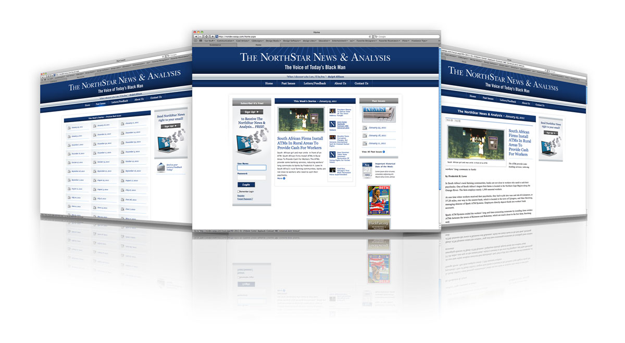
The Web!

Slide 4
Web Page
Document or information resource that is suitable for the World Wide Web
Can be accessed through a web browser
This information is usually in HTML or XHTML format, and may provide navigation to other web pages via hypertext links
Web pages frequently refer to other resources such as style sheets (CSS), scripts (JavaScript) and images into their final presentation

Slide 5
Web Site
Collection of related web pages containing web resources (web pages, images, videos, CSS files, JavaScript files or other digital assets)
Common navigation between web pages
A website is hosted on at least one web server
Accessible via a network (such as the Internet)
All publicly accessible websites collectively constitute the World Wide Web

Slide 6
Web Application
Next level web sites
High interactivity
High accessibility (Cloud)
AJAX, Silverlight, Flash, Flex, etc.
Applications are usually broken into logical chunks called "tiers", where every tier is assigned a role
Desktop-like application in the web browser, Progressive Web Apps (PWAs)
Web applications on desktop (Windows 8/10)

Slide 7
Web 0.0, 1.0, 2.0, 3.0, etc..
Web 0.0 – Developing the internet
Web 1.0 – The shopping carts & static web
Web 2.0 – The writing and participating web
Web 3.0 – The semantic executing web
Web 4.0 – “Mobile Web”
Web 5.0 – Open, Linked and Intelligent Web = Emotional Web
Web according to the press

Slide 8
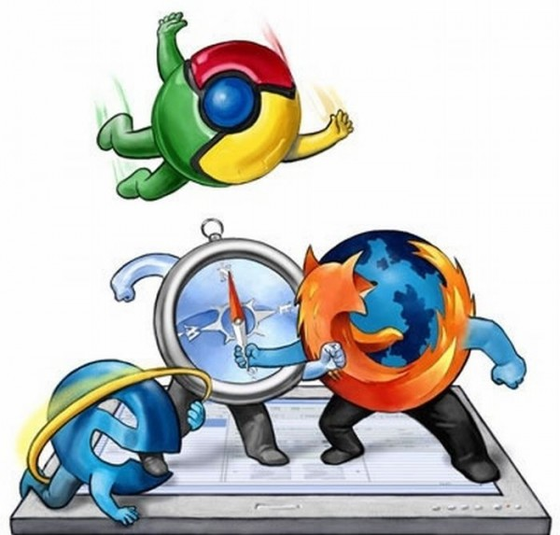
Web Browsers

Slide 9
Browser Market Share

Slide 10
What is a Web Browser?
A web browser (commonly referred to as a browser) is a software application for retrieving, presenting and traversing information resources on the World Wide Web. An information resource is identified by a Uniform Resource Identifier (URI/URL) and may be a web page, image, video or other piece of content. Hyperlinks present in resources enable users easily to navigate their browsers to related resources.
Although browsers are primarily intended to use the World Wide Web, they can also be used to access information provided by web servers in private networks or files in file systems.
Web browsers are built of User Interface, Layout Engine, Rendering Engine, JavaScript engine, UI backend, Networking component and Data persistence component. These components achieve different functionalities of a web browser and together provide all capabilities of a web browser.

Slide 11
Major Web Browsers
Google Chrome
Mozilla Firefox
Apple Safari
Opera
Edge
Internet Explorer
Android
UC Browser
Samsung Internet

Slide 12
User Agent String
Identify web browsers and their version
Can have some additional information like layout engine, user's OS, etc.
Example:
Web browser: Chrome 63.0.3239.132
Rendering (layout) engine: Blink(WebKit Fork)
Operating system: 64-bit Windows 10
Windows NT 6.3 = Windows 10
Mozilla/5.0 (Windows NT 6.3; Win64; x64) AppleWebKit/537.36 (KHTML, like Gecko) Chrome/63.0.3239.132 Safari/537.36

Slide 13
Layout Engine
Software component that displays the formatted content on the screen combining:
Marked up content (such as HTML, XML, image files, etc.)
Formatting information (such as CSS, XSL, etc.)
It "paints" on the content area of a window, which is displayed on a monitor or a printer
Typically embedded in web browsers, e-mail clients, on-line help systems or other applications that require the displaying (and editing) of web content

Slide 14
Layout Engines
Google
WebKit's WebCore till Google Chrome v.28
Blink(forked from WebKit’s WebCore components), since Google Chrome v.28
Mozilla
Gecko, used in Firefox browsers
Opera
Presto, used in Opera browsers till v.15
Blink, used in Opera browsers since v.15
Apple
WebKit's WebCore components used in Safari
Microsoft
Trident, used in Internet Explorer
Tasman, used in Internet Explorer for Mac

Slide 15
JavaScript Engine
A JavaScript engine is process virtual machine which interprets and executes JavaScript (also known as ECMAScript). Although there are several uses for a JavaScript engine, it is most commonly used in web browsers.

Slide 16
JavaScript Engines
Mozilla
Rhino, managed by the Mozilla Foundation, open source, developed entirely in Java
SpiderMonkey (code name), the first ever JavaScript engine, written by Brendan Eich at Netscape Communications
TraceMonkey, a tracing JIT compiler introduced with Firefox 3.5
JägerMonkey, the engine introduced with Firefox 4
IonMonkey, further JIT compiler optimizations for SpiderMonkey, introduced with Firefox 18
OdinMonkey, the engine based on asm.js, introduced with Firefox 22
Google
V8 - open source, developed by Google in Denmark, part of Google Chrome
On 7 December 2010, a new compiling infrastructure named Crankshaft was released, with speed improvements.
Opera
Futhark, by Opera Software, used by Opera web browser versions 9.50 to 10.10 until replaced by Carakan in Opera 10.50 (released March 2010).
Carakan, by Opera Software, used by Opera web browser version 10.50 until switching to V8 with Opera 14 (released in 2013).
Now using Google’s V8

Slide 17
JavaScript engines
Apple
WebKit's JavaScriptCore/SquirrelFish - open source, marketed as Nitro and developed by Apple for Safari
Microsoft
Chakra/JScript , since Internet Explorer 9
Other
KJS - KDE's ECMAScript/JavaScript engine originally developed by Harri Porten for the KDE project's Konqueror web browser
Narcissus open source, written by Brendan Eich, who also wrote SpiderMonkey
Nashorn, open source as part of OpenJDK, written by Oracle Java Languages and Tool Group
JUCE, the open source JUCE C++ toolkit contains an embedded JavaScript interpreter
Tamarin, by Adobe Labs

Slide 18
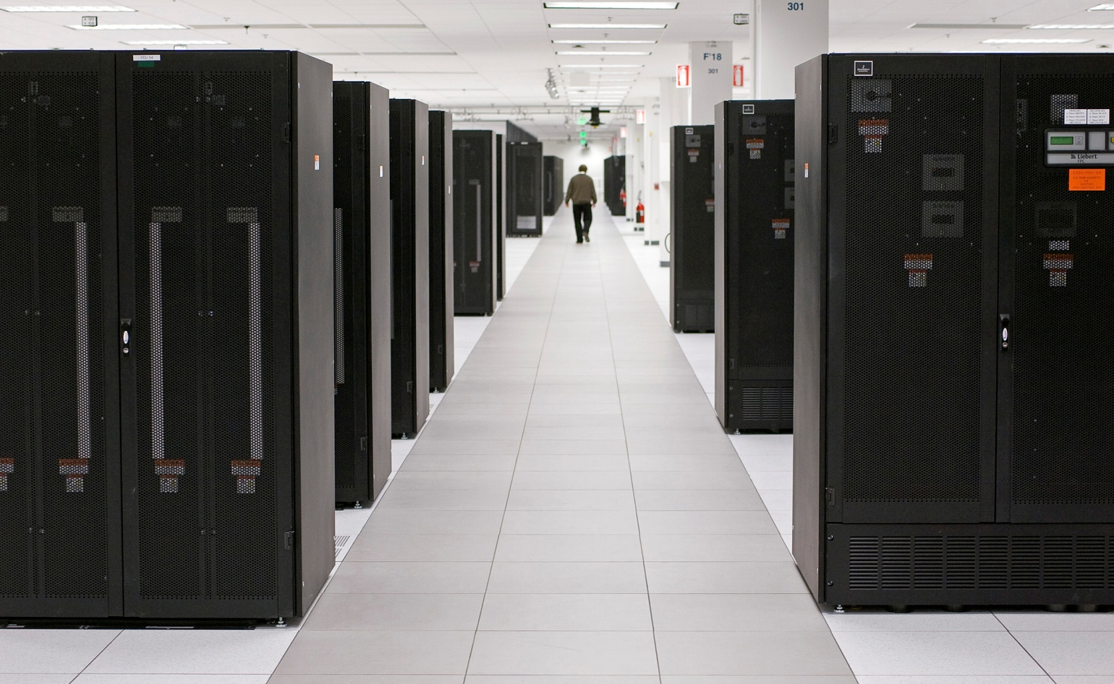
Hardware Servers

Slide 19
What is a Hardware Server?
Physical computer (a hardware system) dedicated to running one or more software services
Servers are placed mainly in collocation centers
The server may be:
Database server
File server
Mail server
Print server
VPS servers
Etc…

Slide 20
(Web) Servers - Software
The Hypertext Transfer Protocol (HTTP) is an application protocol for distributed, collaborative, and hypermedia information systems.^{[1]} HTTP is the foundation of data communication for the World Wide Web.
Apache
Nginx
IIS
Lighttpd
GWS

Slide 21
(Web) Server Operations
Every physical server is controlled by an operating system
Web servers are software products that use the operating system to handle web requests
Web server serves Web content
Implements the Hypertext Transfer Protocol (HTTP) - an application protocol for distributed, collaborative, hypermedia information systems. HTTP is the foundation of data communication for the World Wide Web.
These requests are redirected to other software products (ASP.NET, PHP, JSP, Ruby, etc.), depending on the chosen technology

Slide 22
Web Server Market Share
February 2018 Web Server Survey

Slide 23
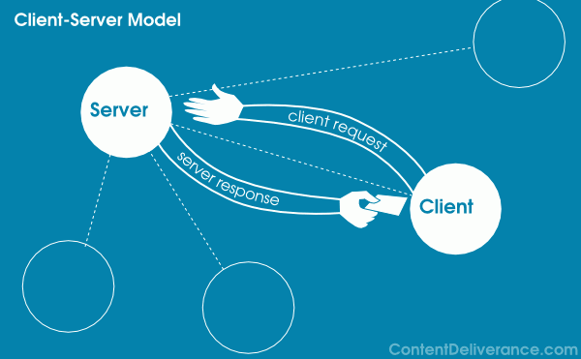
Client-Server

Slide 24
Client-Server Architecture
The client-server model consists of:
Server – a single machine or cluster of machines that provides web applications (or services) to multiple clients
Examples:
Web server running PHP scripts or JSP pages
Apache based Web server
Services in the cloud
Clients –software applications that provide UI (front-end) to access the services at the server
Examples:
Web browsers
HTML5 applications
Mobile apps

Slide 25
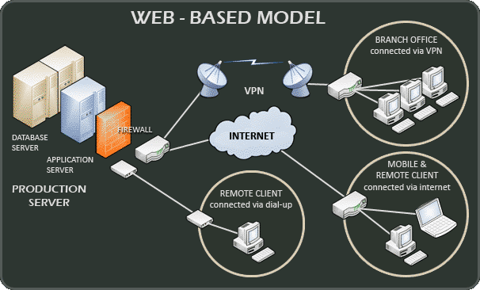
Client-Server Model

Slide 26
Examples
Web server – Web browser
FTP server – FTP client
Email server – Email client
BitTorrent tracker – BitTorrent client
DNS server – DNS client
DHCP server – DHCP client
SMB server – SMB client

Slide 27
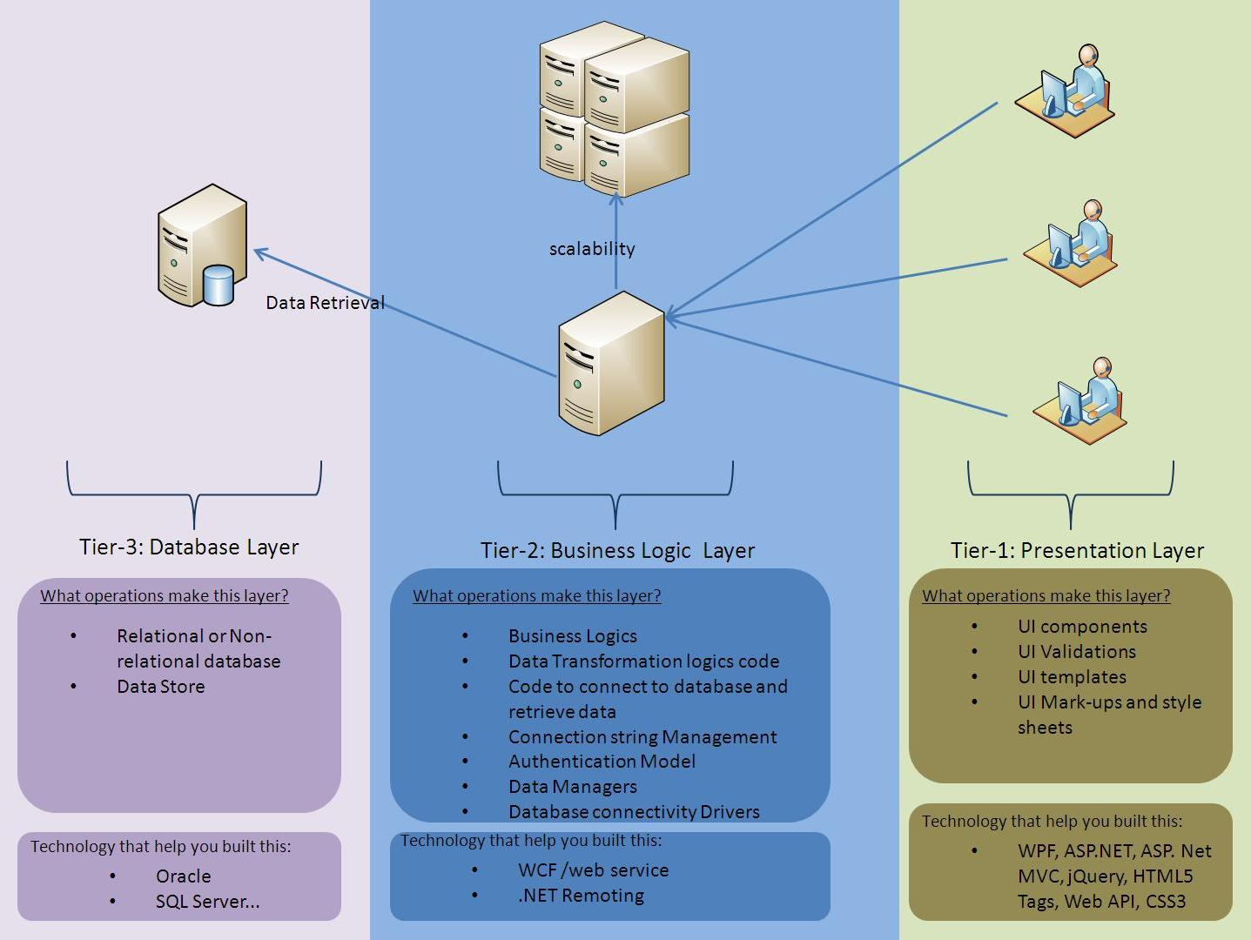
3-Tier / Multi-Tier Architectures

Slide 28
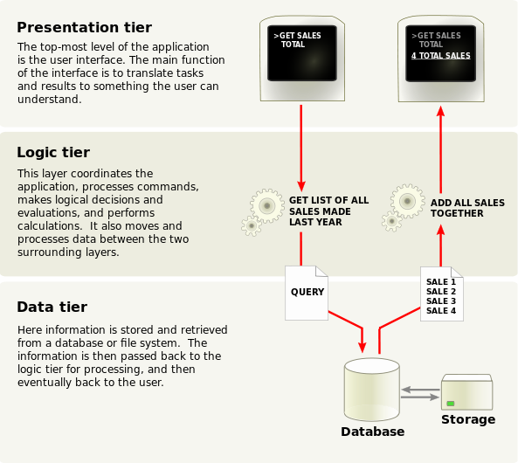
Function of 3-Tier Architecture

Slide 29
3-Tier Related to the Web
A front-end web server serving static content, and potentially some cached dynamic content. In web based application, Front End is the content rendered by the browser. The content may be static or generated dynamically.
A middle dynamic content processing and generation level application server, for example Ruby on Rails, Java EE, ASP.NET, PHP, ColdFusion, Perl, Python platform.
A back-end database or data store, comprising both data sets and the database management system software that manages and provides access to the data.

Slide 30

Typical Layers of the Middle Tier
The middle tier usually has parts related to the front-end, business logic and back-end:
Presentation Logic
Implements the UI of the application (HTML5, Flash, …)
Business Logic
Implements the core processes / services of the application
Data Access Logic
Implements the data access functionality (usually ORM framework)
30

Slide 31
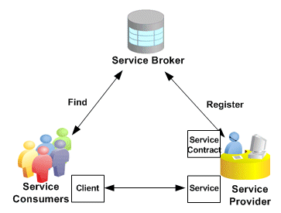
Service-Oriented Architecture (SOA)

Slide 32
What is a Service?
In the real world a "service" is:
A piece of work performed by a service provider
Provides the client (consumer) some desired result by some input parameters
The requirements and the result are known
Easy to use
Always available
Has quality characteristics (price, execution time, constraints, etc.)

Slide 33
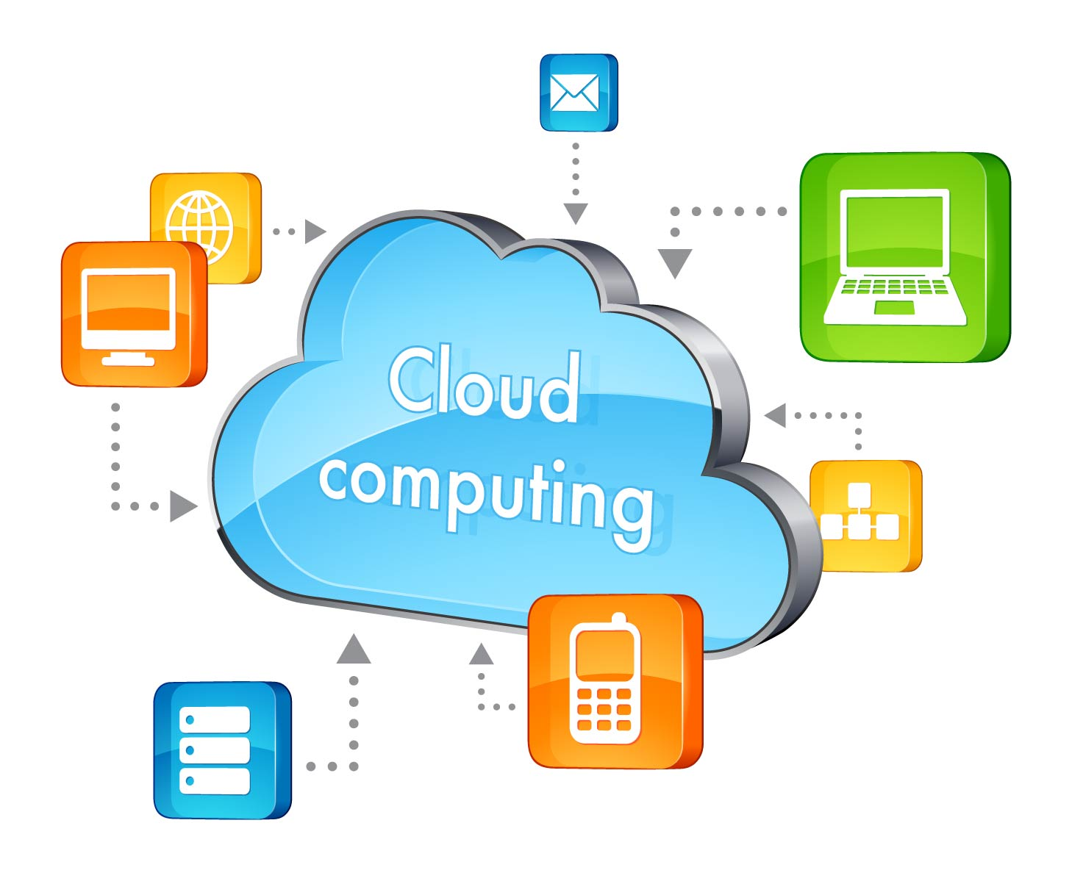
“Cloud” Computing

Slide 34
What is a “Cloud”?
Cloud ≈ multiple hardware machines combine their computing power and resources
Share them between multiple applications
To save costs and use resources more efficiently
Public clouds
Provide computing resources on demand
Publicly in Internet
Paid or free of charge (to some limit)
Amazon AWS, Akamai (Facebook CDN, Bing), Google App Engine, Microsoft Azure, Rackspace, PHPFog, Heroku, AppHarbor

Slide 35
Cloud Computing Models
Infrastructure as a Service (IaaS)
Virtual machines in the cloud on demand
Users install the OS and software they need
Platform as a Service (PaaS)
Platform, services and APIs for developers
E.g. Java + JBoss + JSF + JPA + MongoDB or JavaScript + Node.js + MongoDB + RabbitMQ
Software as a Service (SaaS)
Hosted application on demand (e.g. WordPress, Google Docs etc..)

Slide 36
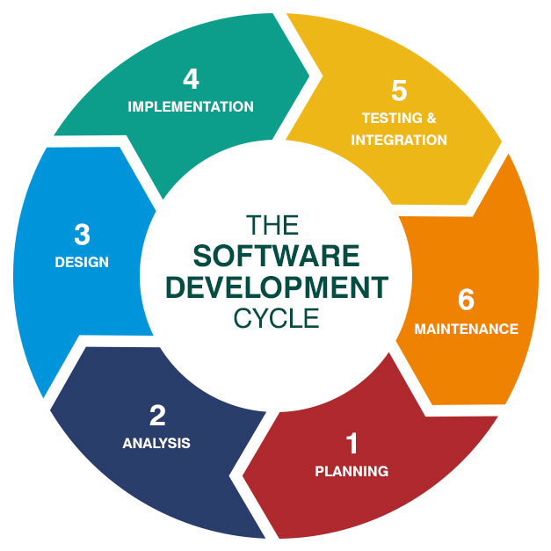
Software Development Cycle

Slide 37
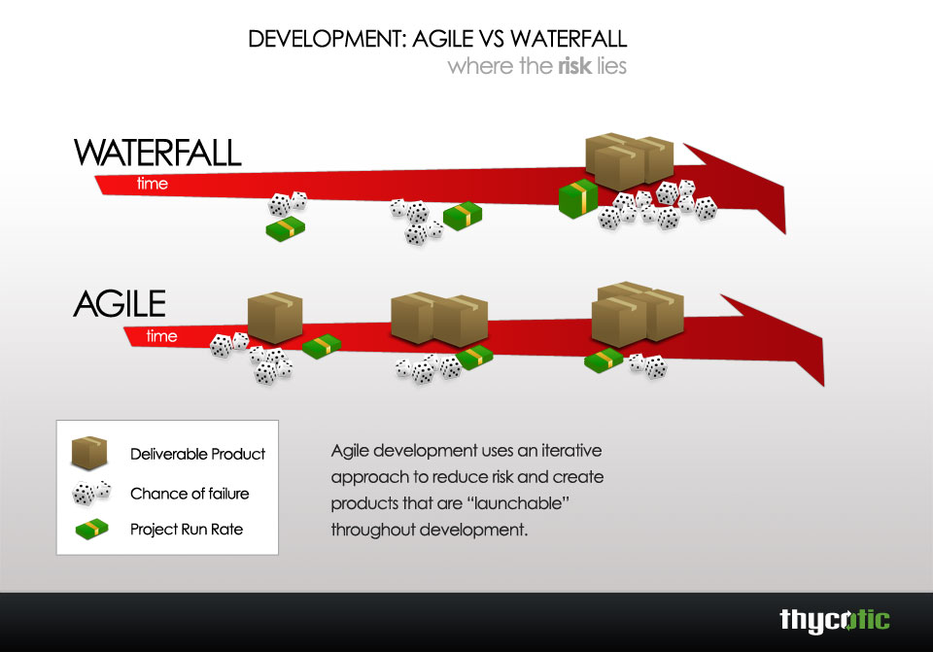
Agile Methodology Intro

Slide 38
Summary
Evolution of Web
Web browsers and components
Web servers
Software architectures used in web
Cloud computing
Software development lifecycle

Slide 39

Questions?

